Slide 1
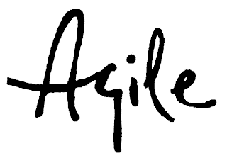
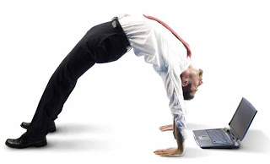
HOW TO LIVE AND SURVIVE LEAN & AGILE IN DAILY BUSINESS
Martin Laza CT RDA DS EU CZ PD AP
Oto Guertler CT RDA DS EU CZ DF FA
Olga Sebestova CT RDA DS EU CZ RA QM
Andrej Cizmar CT RDA DS EU CZ RA HW

Slide 2

Agenda
Morning:
9:00 – 9:10 Introduction
9:10 – 9:30 Expectations
9:30 – 10:00 Marshmallow challenge
10:00 – 10:10 Marshmallow movie
10:10 – 10:20 Break
10:20 – 11:00 Agile project and roles
11:00 – 12:00 Lunch
Afternoon:
12:00 – 12:10 Product vision
12:10 – 12:20 Elevator pitch
12:20 – 12:30 Epic, user stories, tasks
12:30 – 12:40 AC, DoD, DoR
12:40 – 13:00 Multitasking game
13:00 – 13:10 Break
13:10 – 15:00 Lego play
15:00 – 15:10 Go, look, see excercise
15:10 – 15:30 SDS
15:30 – 16:00 Review

Slide 3
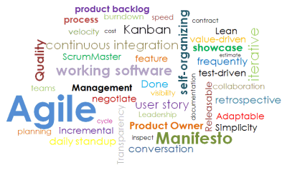
Expectations
Who are you and what do you want to get out of today?

Slide 4
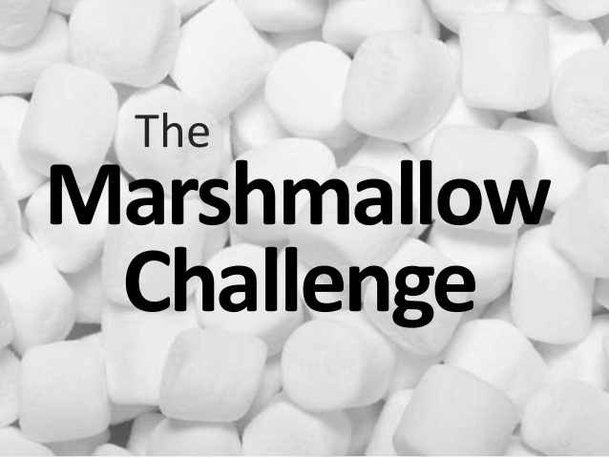
.
The Marshallow challenge
https://www.youtube.com/watch?v=H0_yKBitO8M
https://www.online-stopwatch.com/countdown/

Slide 5
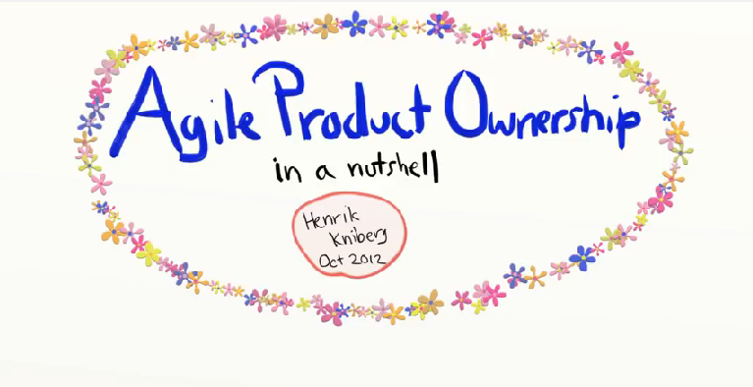

.
Agile project and roles
https://www.youtube.com/watch?v=502ILHjX9EE

Slide 6
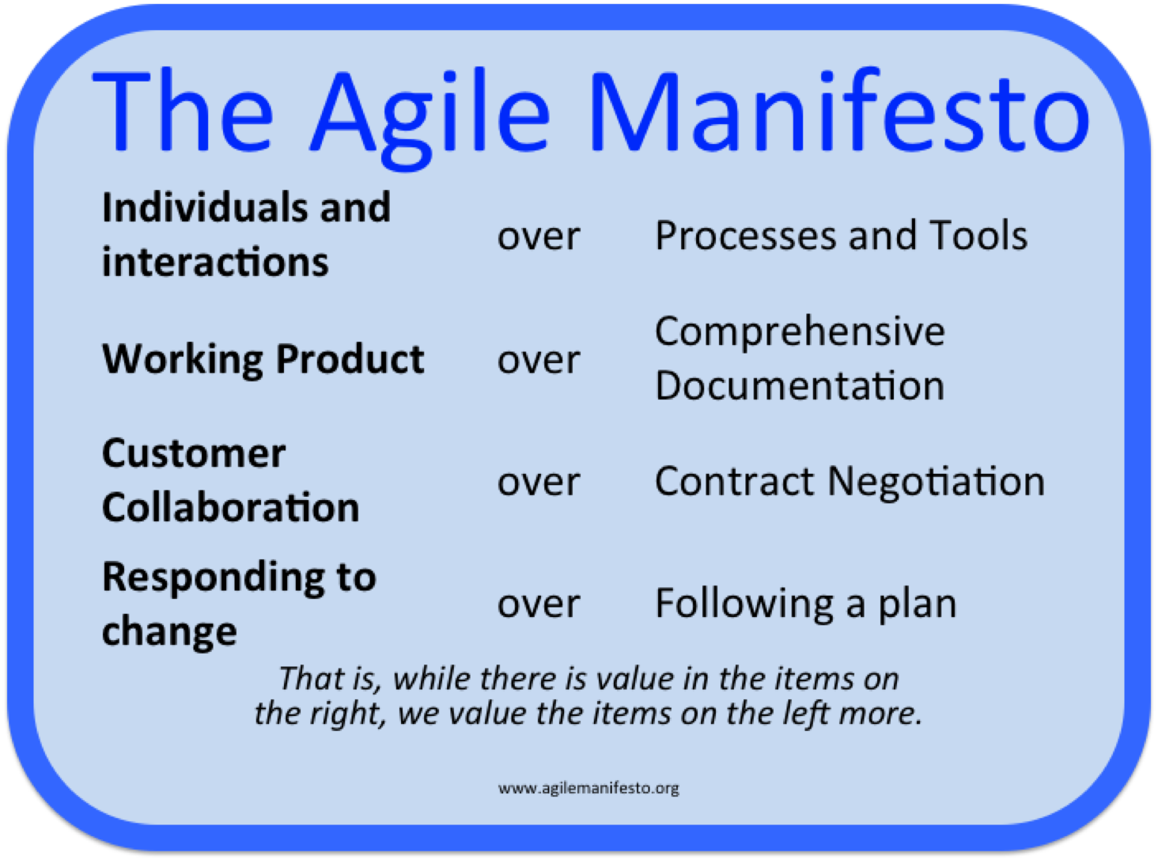
.

Slide 7
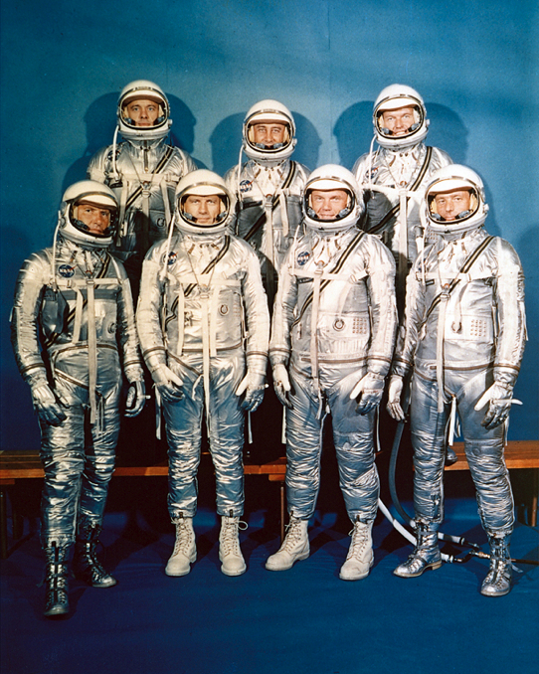
.
Product vision
Vision for landing on the moon
"I believe that this nation should commit itself to achieving the goal, before this decade is out, of landing a man on the moon and returning him safely to the Earth.“
President Kennedy, May 25, 1961

Slide 8
.
Defining a Product vision
Is it S.M.A.R.T?
Specific – Is it specific?
Measurable – Indicator of progress?
Assignable\ Achievable – Who can do it?
Realistic – Resources, knowledge
Time bounded – By when?
President Kennedy, May 25, 1961

Slide 9
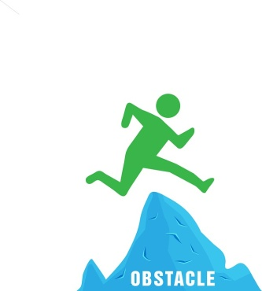
.
Elevator pitch
Template:
FOR <target customer>
WHO <statement of the need>
THE <product name>
IS A <product category>
THAT <key benefit>
UNLIKE <primary competitor>
OUR PRODUCT <further differentiation>
(From Geoffrey Moore, Crossing the Chasm)
Example:
For the OEM,
who wants to commission a drive,
the trace functionality
is a diagnostic support tool,
that can drastically reduce the commissioning time
Unlike the drive of company XXXX
Our trace adjusts automatically to the required recording time and …

Slide 10
.
Alternative Elevator pitch
Three models:
Why – How – What
Super Effective, Very hard to get right
Problem – Solution – Profit
Medium difficulty, can be limiting
What – So what – Now what
Easiest, most common
(From Start with why; Think Fast, Talk Smart)
Examples:
To equip the very best athletes, we produce the highest quality products – such as these shoes (Nike, paraphrased)
Taxis are not always available, and not everyone wants to own a car or use public transport. Uber solves that by providing cheap, available rides. By using Uber, you can save money, time, and enjoy a quiet drive (Uber, paraphrased)
The LEIA project measures gas concentrations very accurately. Using it cuts operational costs, reduces risks, and provides greater insight into the industrial process. You can buy it from our sales department (Siemens, paraphrased)

Slide 11
Epic, user stories, tasks
User Story
“short, simple description of a feature told from the perspective of the person who needs the feature (usually a user or customer)”
Template:
As a < role>
I want < goal/desire >,
so that < benefit>
Example:
As a user, who often uses the website
I want the system to save my customer data,
so that I can do my shopping faster.

Slide 12
AC, DoD, DoR
Acceptance criteria (AC)
to clarify what the team should build before they start work
to ensure everyone has a common understanding of the ..problem
to help the team members know when the Story is .. ..complete
to help verify the Story via automated tests.
Definition of Done (DoD) an agreement between Development Team and the Product Owner on what needs to be completed for each user story – and it is often standardized across the company in order to guarantee consistent delivery of quality
Definition of Ready (DoR) - clear, feasible and testable, “garbage in, garbage out” Task - is deliberately vague, allowing the precise details that will help the implementation to be discovered at the last responsible moment. Acceptance Criteria are the precise details.
Acceptance Criteria (AC)
Definition of Ready (DoR)
Task
Definition of Done
(DoD)

Slide 13

Multitasking game
Agile

Slide 14
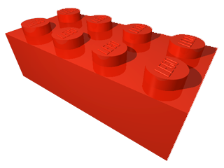
.
SIEMENS LEGO CITY
Vision:
For all the commuting employees,
who wants behave green,
the new SIEMENS LEGO CITY
is a bicycle friendly Siemens campus,
that can drastically reduce CO2 produced by commuting
Unlike our competitor Valeo
Our proximity of Siemens Office building and apartments for our employees creates unique environment friendly concept with balanced work/life ratio

Slide 15
.
Scrum Master responsibilities
Helping the team to reach consensus for what can be achieved during a specific period of time
Helping the team to reach consensus during the daily scrum
Helping the team to stay focused and follow the agreed-upon rules for daily scrums
Removing obstacles that are impeding the team's progress
Protecting the team from outside distractions

Slide 16
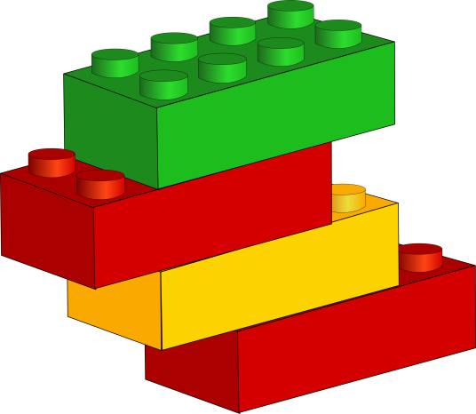

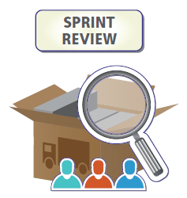


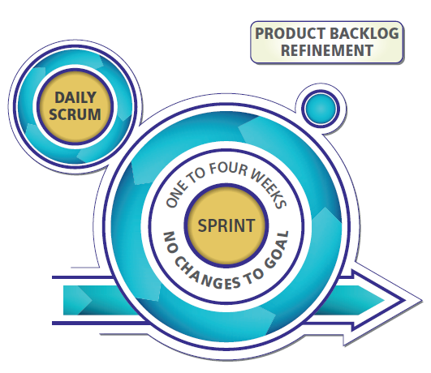
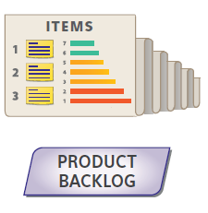
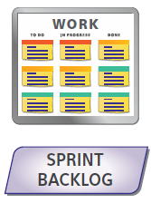

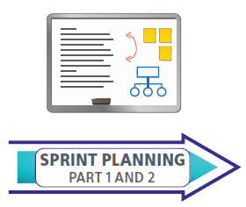
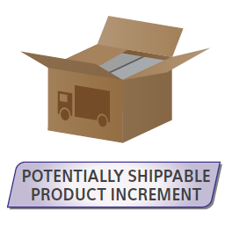
.
LEGO PLAY
Epics/Stories
Plan
2 x 5min
Tasks
10 Minutes
Deliver
Check/Learn

Slide 17
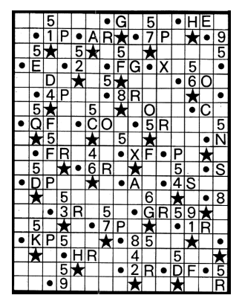
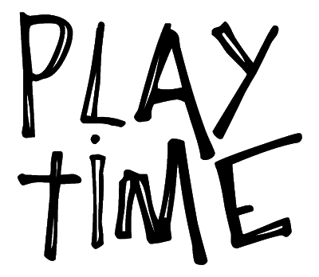
Go, look, see

Slide 18
.
How does it correspond to SDS?
From technical perfectionism and 100 % plan
to continuous customer focus and innovation speed
1
Focus on customer value and eliminate
waste
Respect People
Establish
pull and
flow
Improve continuously
#SDS
Optimize the entire value stream
Go and See
Deliver fast and create knowledge
Build quality in from the beginning
8 Siemens Development System (SDS) Principles

Slide 19
.
How does it correspond to SDS?
1
Value
stream mapping
Structured problem solving
(e.g. A3)
CEO driven Hoshin Kanri
Retro- spectives
Time Boxed Development
Visual Management
Scrum
Self-organizing / cross functional teams
Ranked Backlog
Gemba walk
Value effort matrix
Minimal viable / marketable product
MVP/ MMP
Kanban – WIP limits, definition of done
Daily stand-up meetings
14 Siemens Development System (SDS) Methods

Slide 20

REVIEW
Review What you got out, share with a colleague
Review Car Park
Review Expectations
Training Feedback

